Slide 1

Topic: Business communication Sir, Muhammad Zaman Hashmi

Slide 2
“Think before you speak. Read before you think.” Fran Lebowitz,
What is Communication?
it derived from a Latin word “Communis or communicatio” which means to share
Information
Feelings
Ideas
Thoughts
Needs
Reporting
Transmission
by speaking, writing, or using some other medium
:

Slide 3
Communication According Scholars
According to Ricks and Gow defined Business Communication as a system that is responsible to affect change throughout the whole organization.
According to W.H. Business Communication is exchanging business-related different views, ideas, and news within the related parties.
Prof. J. Haste stated that when the communication occurs between either two or more than two business people for the purpose of effective organization and administration of business then it is considered as Business Communication.

Slide 4
why is communication important?
Men is social animal
Talking is a basic drive, but communication is a learned activity. Roving
Improving upon the ability to talk is to speak well and communicate effectively.
Communication connects people together in the society, modifies behavior and bring change.
Communication plays an important role in almost all the aspects of life.
Helping obtaining employment and successful job performance

Slide 5
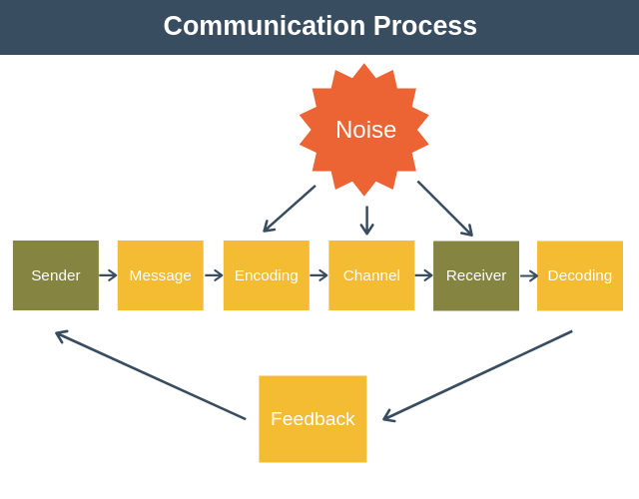
The communication process

Slide 6
Communication Process
Sender: This is the person that is delivering a message to a recipient.
Message: This refers to the information that the sender is relaying to the receiver.
Encoding: The sender begins with the encoding process wherein he uses certain words or non-verbal methods such as symbols, signs, body gestures, etc.
Communication Channel: This is the transmission or method of delivering the message.
Receiver: The receiver is the person who is getting or receiving the message.
Decoding: This is the interpretation of the message. Decoding is performed by the receiver.
Feedback: In some instances, the receiver might have feedback or a response for the sender.
Note: The Noise shows the barriers in communications.

Slide 7
Problems in Communication
Choose of words very important
Understanding the contextual meaning ( hand)
Misunderstanding of misconception
Cultural meaning
“Listen with curiosity. Speak with honesty. Act with integrity. The greatest problem with communication is we don’t listen to understand. We listen to reply. When we listen with curiosity, we don’t listen with the intent to reply. We listen for what’s behind the words.” Roy T. Bennett, The Light in the Heart
“Men of few words are the best men." ― William Shakespeare,

Slide 8
4 Types of Business Communication
1. Upward communication
This type of business communication allows upper management to stay informed about what is happening with the company.
Examples:
Direct report to manager
Manager to high-level executive
2. Downward communication
Downward communication refers to the exchange of information from the top of an organization down to lower levels of the organizational chain of command.
Examples
Executive to manager
Manager to direct report

Slide 9
3. Lateral communication
When employees communicate across departments or with peers of equal rank in the organization, this is considered lateral or horizontal communication.
Examples
Coworker to coworker
Manager to manager
4. External communication
External communication deals with the exchange of information from within the organization to parties outside of the organization.
Examples:
Organization A to Organization B
Website to consumer

Slide 10
Thank You for Patiently Listening!

